Slide 1

Operating system

Slide 2
Outline
Deadlock
Necessary condition for deadlock
Deadlock prevention

Slide 3
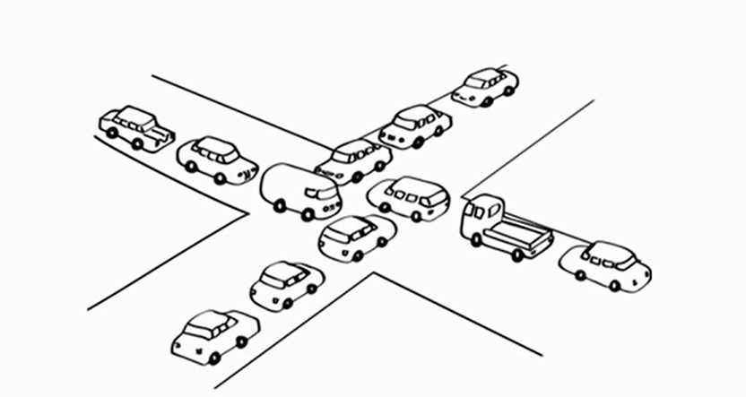
deadlock
deadlock
A Deadlock is a situation where each of the computer process waits for a resource which is being assigned to some another process. In this situation, none of the process gets executed since the resource it needs, is held by some other process which is also waiting for some other resource to be released.
If a deadlock occurs, it can be resolved if one car backs up (preempt resources and rollback)

Slide 4
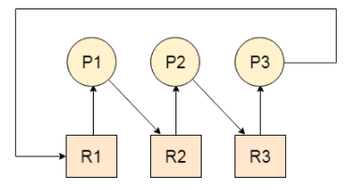
deadlock
Example: Let us assume that there are three processes P1, P2 and P3. There are three different resources R1, R2 and R3. R1 is assigned to P1, R2 is assigned to P2 and R3 is assigned to P3.
After some time, P1 demands for R1 which is being used by P2. P1 halts its execution since it can't complete without R2. P2 also demands for R3 which is being used by P3. P2 also stops its execution because it can't continue without R3. P3 also demands for R1 which is being used by P1 therefore P3 also stops its execution. In this scenario, a cycle is being formed among the three processes. None of the process is progressing and they are all waiting. The computer becomes unresponsive since all the processes got blocked.

Slide 5
Necessary conditions for Deadlock
Mutual Exclusion
A resource can only be shared in a mutually exclusive manner. It implies, two process cannot use the same resource at the same time.
2. Hold and Wait
A process waits for some resources while holding another resource at the same time.
3. No preemption
The process that once scheduled will be executed till the completion. No other process can be scheduled by the scheduler meanwhile.
4. Circular Wait
All the processes must be waiting for the resources in a cyclic manner so that the last process is waiting for the resource which is being held by the first process.

Slide 7
Deadlock handling Methods
Deadlock prevention
Design such protocols that there is no possibility of deadlock
Deadlock avoidance
Try to avoid in run time so ensuring the system will never enter a deadlock state
Deadlock detection and recovery
Allow the system to enter in deadlock state then solve it
Deadlock Ignorance
Simply ignore the problem

Slide 8
Deadlock Prevention (Violate any one of the condition )
Mutual Exclusion
Hold and Wait
Conservative approach (can run iff it has acquired all resources)
Alternative protocol (take it use it and release before asking for another resource)
Wait time out (timeout timer)
No Pre-emption
Considering Priority (For both waiting and running processes)
Circular wait
Natural number mapping (process can request only in increasing order)

Slide 9
Deadlock Prevention Strategies for handling Deadlock
Deadlock happens only when Mutual Exclusion, hold and wait, No preemption and circular wait hold simultaneously. If it is possible to violate one of the four conditions at any time then the deadlock can never occur in the system. i.e., if we are able to violate one of the four necessary conditions and don't let them occur together then we can prevent the deadlock.
1. Mutual Exclusion
Resource can never be used by more than one process simultaneously which is fair enough but that is the main reason behind the deadlock. If a resource could have been used by more than one process at the same time then the process would have never been waiting for any resource. We cannot force a resource to be used by more than one process at the same time since it will not be fair enough and some serious problems may arise in the performance. Therefore, we cannot violate mutual exclusion for a process practically.

Slide 10
Deadlock Prevention Strategies for handling Deadlock
2. Hold and Wait: Hold and wait condition lies when a process holds a resource and waiting for some other resource to complete its task. Deadlock occurs because there can be more than one process which are holding one resource and waiting for other in the cyclic order.
However, we have to find out some mechanism by which a process either doesn't hold any resource or doesn't wait. That means, a process must be assigned all the necessary resources before the execution starts. A process must not wait for any resource once the execution has been started.
This can be implemented practically if a process declares all the resources initially. However, this sounds very practical but can't be done in the computer system because a process can't determine necessary resources initially.
3: No Preemption: Deadlock arises due to the fact that a process can't be stopped once it starts. However, if we take the resource away from the process which is causing deadlock then we can prevent deadlock.
This is not a good approach at all since if we take a resource away which is being used by the process then all the work which it has done till now can become inconsistent

Slide 11
Deadlock Prevention Strategies for handling Deadlock
4: Circular Wait
To violate circular wait, we can assign a number to each of the resource. A process can't request for a number resource if it is holding a higher number resource. This ensures that not a single process can request a resource which is being utilized by some other process and no cycle will be formed.

Slide 12
Problem with deadlock prevention
Not feasible always, costly, there may exist some other more feasible solutions.

Slide 13
Thank You

